Slide 1
Agenda 10/21
Welcome and Q&A
Course objectives review
Lecture – Wide Area Networks (Chapter 10)
Quiz 5 – Chapters 8 and 9
Reminder – Assignment # 6 due tonight, Final Exam next week

Slide 2

Wide Area Networks
Chapter 10
Panko and Panko
Business Data Networks and Security, 9th Edition
© 2013 Pearson

Slide 3
LANs, MANs, and WANs
Access Lines
The Network Core
Using the Internet for Wide Area Networking
Cellular Data Service
Virtual WANs

Slide 4
10.1: LANs, MANs, and WANs
Local Area Networks (LANs)
On the customer premises
Wide Area Networks (WANs)
Connect sites across a region, country, the world
Metropolitan Area Networks (MANs)
Connect sites in a single metropolitan area (a city and its suburbs)
A type of WAN

Slide 5
10.1: LANs, MANs, and WANs
 | LAN | MAN | WAN
Implementation | Self | Carrier | Carrier
Ability to choose technology | High | Low | Low
Who manages the network? | Self | Carrier | Carrier

Slide 6

10.1: LANs, MANs, and WANs
 | LAN | MAN | WAN
Price | Highly related to cost | Highly unpre-dictable | Highly unpre-dictable
Cost per bit transmitted | Low | Medium | High
Therefore, typical speed range | 100 Mbps to 1 Gbps or more | 10 to 100 Mbps | 1 to 50 Mbps

Slide 7
10.1: LANs, MANs, and WANs
 | LAN | MAN | WAN
Can use switched technology? | Yes | Yes | Yes
Can use routed technology? | Yes | Yes | Yes

Slide 8
10.2: Single Networks versus Internets
Technology | LAN | WAN
Can be a single switched or wireless network? | Yes | Yes
Can be an internet? | Yes | Yes

Slide 9
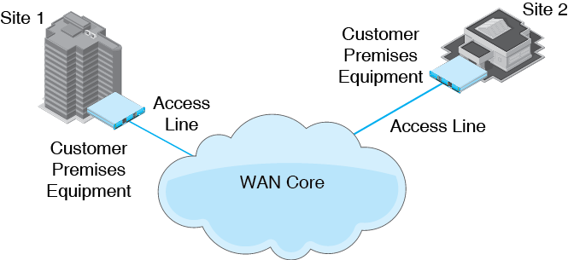
10.3: Components of a WAN

Slide 10
LANs, MANs, and WANs
Access Lines
The Network Core
Using the Internet for Wide Area Networking
Cellular Data Service
Virtual WANs

Slide 11
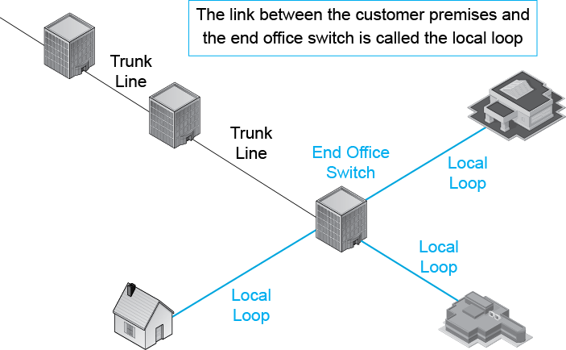
10.4: PSTN Local Loop

Slide 12
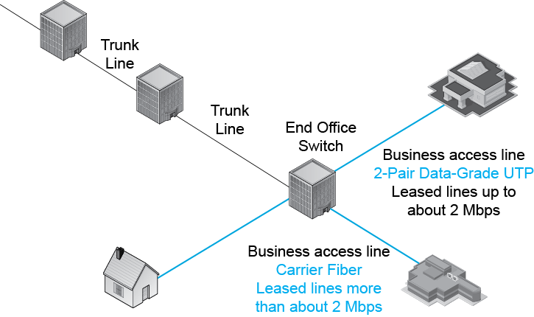
10.4: PSTN Local Loop

Slide 13
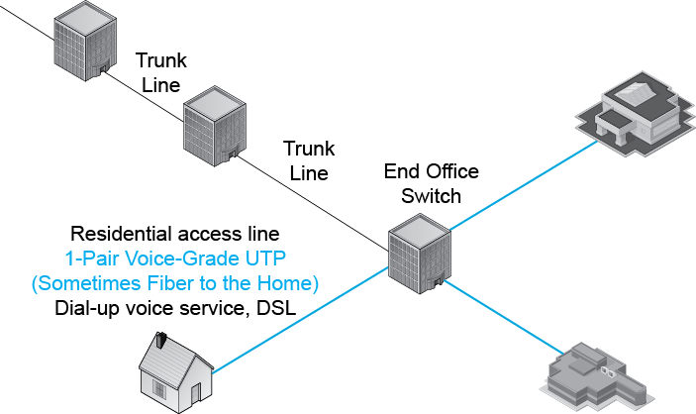
10.4: PSTN Local Loop

Slide 14

10.5: Local Loop Technologies
Purpose | Local Loop Technology | Considerations
Business Local Loop | 2-pair data-grade UTP | For leased lines up to about 2 Mbps Must be pulled to the customer premises Not limited to 100 meters
 | Optical fiber (carrier fiber) | For leased lines more than about 2 Mbps Must be pulled to the customer premises

Slide 15
10.5: Local Loop Technologies
Purpose | Local Loop Technology | Considerations
Residential Local Loop | 1-pair voice-grade UTP | Designed only for voice transmission Can be used for digital subscriber line (DSL) service Not limited to 100 meters Already installed; avoids cost of pulling media
 | Optical fiber (carrier fiber) | Fiber to the home New Installed in entire neighborhoods to reduce cost

Slide 16
10.5: Local Loop Technologies
Purpose | Local Loop Technology | Considerations
Internal Data Wiring | 4-pair UTP (Category 3-6A) | For inside a site Usually limited to 100 meters
 | Multimode optical fiber | Limited to about 300 meters

Slide 17
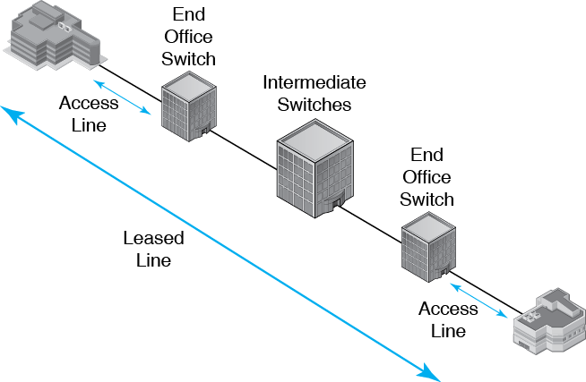
10.6: Access Lines v Leased Lines

Slide 18
10.7: Dial-Up Lines v Leased Lines
Characteristic | Dial-Up Connections | Leased Lines
Connectivity | Point-to-any-point (Any-to-Any) | Point-to-point
Connection Period | Duration of a call | Duration of the lease (always on)
Payment | By the minute for long distance calls | Flat rate plus per-use changers
Commitment | None (except for cellular plans) | Duration of the lease
Data Transmission Speed | Low to moderate | Moderate to high

Slide 19
10.8: Leased Line Speeds
North American Digital Hierarchy
T1 | 1.544 Mbps | 2-Pair Data-Grade UTP
Fractional T1 | 128 kbps, 256 kbps, 384 kbps, 512 kbps, 768 kbps | 2-Pair Data-Grade UTP
Bonded T1s (multiple T1s acting as a single line) | Small multiples of 1.544 Mbps | 2-Pair Data-Grade UTP
T3 | 44.736 Mbps | Carrier Optical Fiber

Slide 20
10.8: Leased Line Speeds
CEPT Hierarchy (Europe)
Fractional E1 |  | 2-Pair Data-Grade UTP
E1 | 2.048 Mbps | 2-Pair Data-Grade UTP
Bonded E1 | Small multiples of 2.048 Mbps | 2-Pair Data-Grade UTP
E3 | 34.368 Mbps | Carrier Optical Fiber

Slide 21
10.8: Leased Line Speeds
SONET/SDH Speeds
OC3/STM1 | 155.52 Mbps | Carrier Optical Fiber
OC12/STM4 | 622.08 Mbps | Carrier Optical Fiber
OC48/STM16 | 2,488.32 Mbps | Carrier Optical Fiber
OC192/STM64 | 9,953.28 Mbps | Carrier Optical Fiber
OC768/STM256 | 39,813.12 Mbps | Carrier Optical Fiber

Slide 22
10.9: Digital Subscriber Lines (DSLs)
Feature | ADSL | VHDSL | HSDL | HSDL2 | SHDSL
Name | Asymmet-ric DSL | Very-High-Bit- Rate DSL | High-Rate Symmetric DSL | High-Rate Symmetric DSL Version 2 | Super-High Rate Symmetric DSL
Uses existing 1-pair VG UTP? | Yes* | Yes* | Yes* | Yes* | Yes*
Target Market | Residences | Residen- tial multi-tenent buildings | Business | Business | Business
* Duh. That’s the definition of DSLs.

Slide 23
10.9: Digital Subscriber Lines (DSLs)
Feature | ADSL | VHDSL | HSDL | HSDL2 | SHDSL
Down-stream | Initially, 1.5 Mbps; now up to 12 Mbps | 52 to 100 Mbps | 768 kbps | 1.544 Mbps | 384 kbps to 2-3 Mbps
Upstream | Initially, up to 0.5 Mbps; now up to 3.3 Mbps | 16 to 100 Mbps | 768 kbps | 1.544 Mbps | 384 kbps to 2-3 Mbps
Speed Symmetry? | No | Yes or No | Yes | Yes | Yes
QoS SLA? | No | No | Yes | Yes | Yes

Slide 24
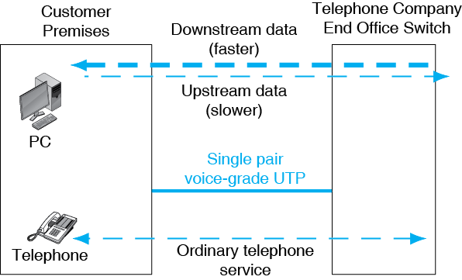
10.10: Asymmetric Digital Subscriber Line (DSL) Service

Slide 25
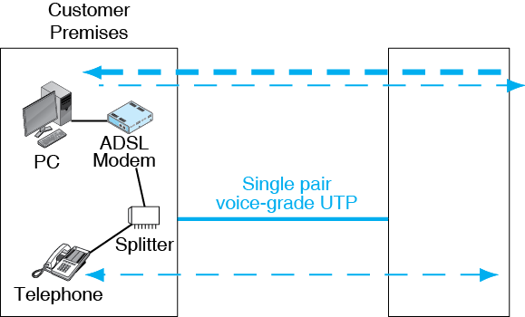
10.10: Asymmetric Digital Subscriber Line (DSL) Service

Slide 26
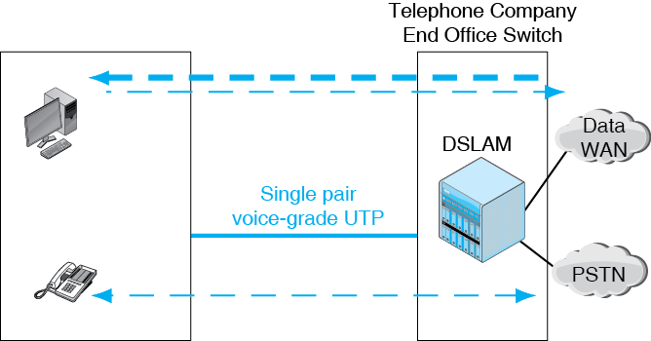
10.10: Asymmetric Digital Subscriber Line (DSL) Service
DSLAM = DSL Access Multiplexer

Slide 27
Cable Modem Service
Coaxial cable service was created to bring television to homes that had poor over-the- air reception
Now also offers two-way data service called cable modem service
Popular in the United States
Not popular in most countries

Slide 28
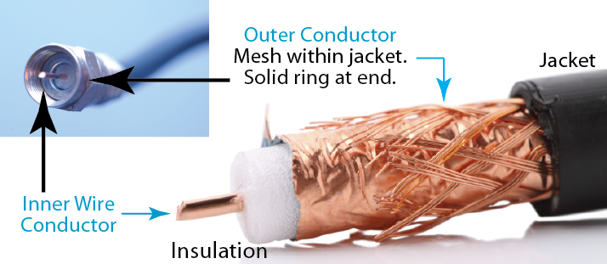
10.12: Coaxial Cable
Two conductors: central wire and coaxial ring

Slide 29
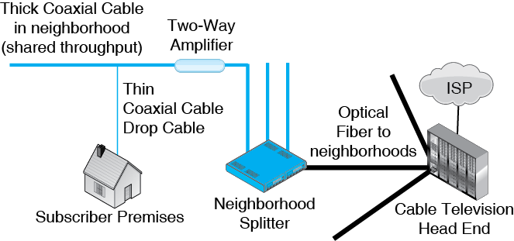
10.11: Cable Modem Service

Slide 30
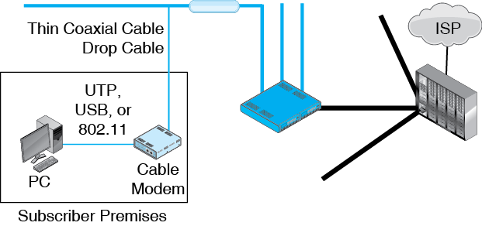
10.11: Cable Modem Service

Slide 31
ADSL versus Cable Modem Service
In general …
Cable modem service offers somewhat faster individual throughput at a somewhat higher cost.
ADSL service offers somewhat slower individual throughput at a somewhat lower cost.

Slide 32
LANs, MANs, and WANs
Access Lines
The Network Core
Using the Internet for Wide Area Networking
Cellular Data Service
Virtual WANs

Slide 33
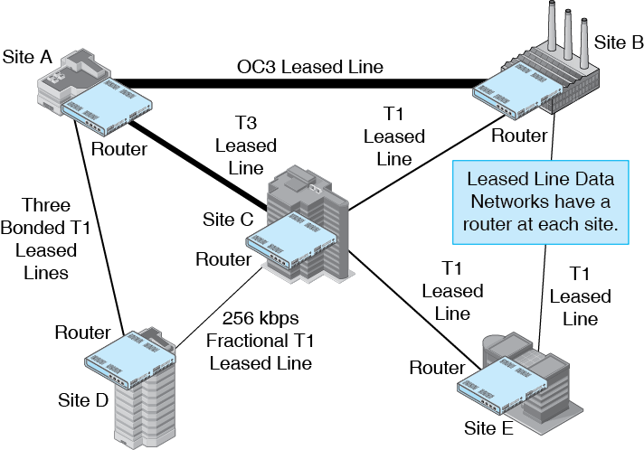
10.13: Leased Line Data Network

Slide 34
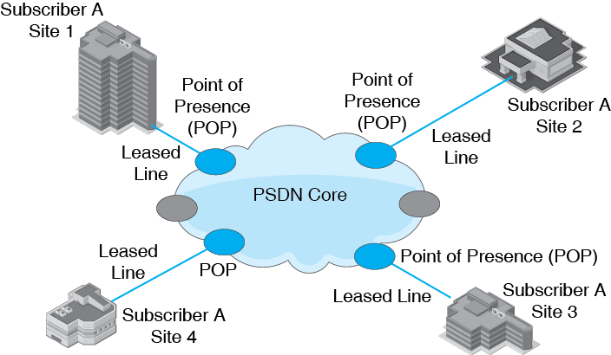
10.14: Public Switched Data Network (PSDN)

Slide 35
10.15: Switched Data Network Standards
X.25
1970s technology
Slow and expensive
Gone today
Frame Relay
ATM
Metropolitan Area Ethernet

Slide 36
10.15: Switched Data Network Standards
Frame Relay
Started to grow in the 1990s
Inexpensive and fast compared to X.25
256 kbps to about 40 Mbps
This is the range of greatest corporate demand for WAN speeds

Slide 37
10.15: Switched Data Network Standards
Frame Relay
Grew rapidly in the 1990s thanks to low prices
Took market share away from leased line corporate networks
Carriers have raised their prices to improve profit margins
This has reduced growth
Many companies are going back to leased lines for many links

Slide 38
10.15: Switched Data Network Standards
ATM
Much higher speeds than Frame Relay, at much higher prices
Speeds of 1 Mbps to gigabits per second
Adoption for PSDN service has been limited
Created to replace the core of the Public Switched Telephone Network
Widely adopted for the Public Switched Telephone Network core

Slide 39
10.15: Switched Data Network Standards
Metropolitan Area Ethernet
Metropolitan area network (MAN): city &environs
Smaller distances than national or international WANs, so lower prices and higher speeds
Speeds of 1 Mbps to 100 Mbps
No learning is needed because all firms are familiar with Ethernet
Carrier can provision or re-provision service speed rapidly, giving flexibility
The only PSDN service growing rapidly

Slide 40
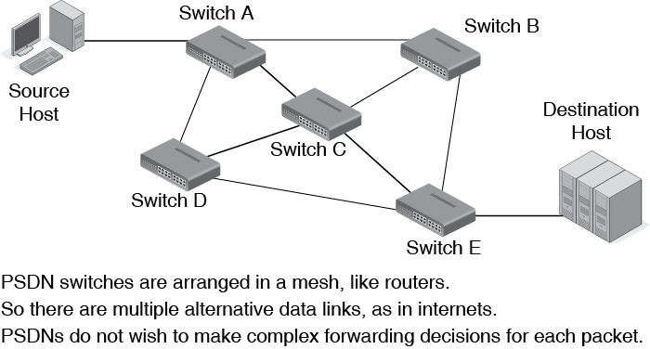
10.16: Virtual Circuit Operation
Box

Slide 41
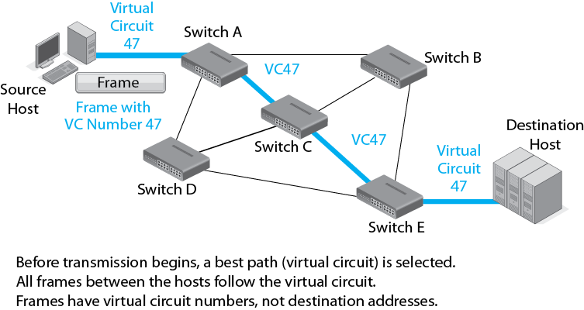
10.16: Virtual Circuit Operation
Box

Slide 42
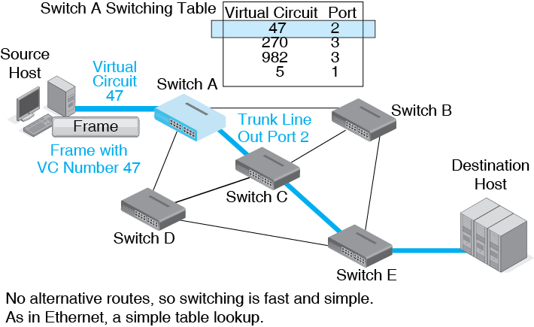
10.16: Virtual Circuit Operation
Box

Slide 43
LANs, MANs, and WANs
Access Lines
The Network Core
Using the Internet for Wide Area Networking
Cellular Data Service
Virtual WANs

Slide 44
10.17: Using the Internet for Wide Area Networking
The Internet is a Wide Area Network
Many corporations are beginning to use the Internet for some part of their WAN traffic.
In the future, the Internet is likely to carry most corporate site-to-site traffic and other WAN traffic.

Slide 45
10.17: Using the Internet for Wide Area Networking
Attractions
The price per bit transmitted is very low because of large economies of scale.
All corporate sites, employees, customers, suppliers, and other business partners are connected to the Internet.
Issues
The security of traffic flowing over the Internet
Variable quality of service, with no guarantees

Slide 46
Securing the Internet
Border firewall at each site
Virtual private networks
IPsec encryption for sensitive information
SSL/TLS for less sensitive information
Antivirus filtering

Slide 47
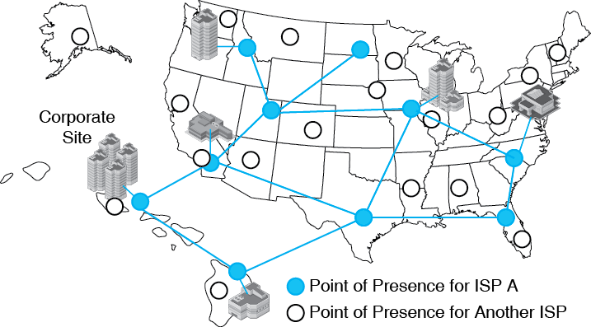
10.18: Connecting All Corporate Sites to a Single ISP
If all sites connect to a single ISP, the ISP can provide QoS guarantees.

Slide 48
LANs, MANs, and WANs
Access Lines
The Network Core
Using the Internet for Wide Area Networking
Cellular Data Service
Virtual WANs

Slide 49
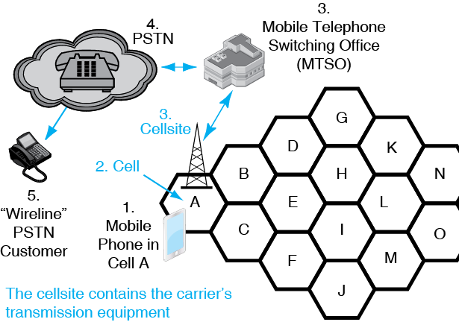
10.19: Cellular Technology

Slide 50
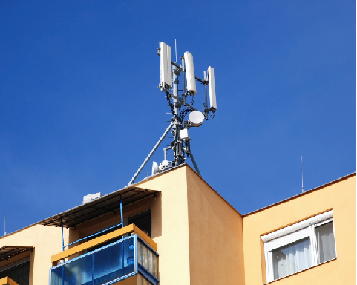
10.20: Cellsite for Mobile Telephones
Cellular
Antennas
Point-to-Point Microwave
Antenna to MTSO
Cellsite

Slide 51
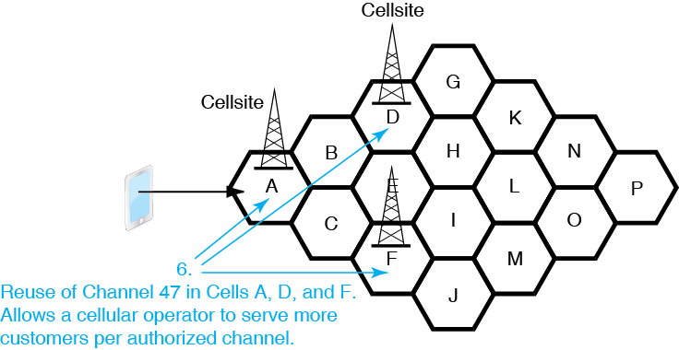
10.19: Cellular Technology

Slide 52
10.21: Cellular Technology
Channel Reuse
The same channel can be used in multiple cells.
This allows subscribers to use the same channel if they are in different sites.
Consequently, the carrier can serve more customers per channel.

Slide 53
10.21: Cellular Technology
Channel Reuse
Channel reuse in adjacent cells
The concern is interference between cellsites and customers using the same channel in adjacent cells.
Some cellular technologies allow channel reuse in adjacent cells, others do not.

Slide 54
10.21: Cellular Technology
Channel Reuse
Example without channel reuse:
500 channels, so only 500 simultaneous subscribers can be served
Channel reuse factor (varies): 20
Number of simultaneous calls supported: 10,000

Slide 55
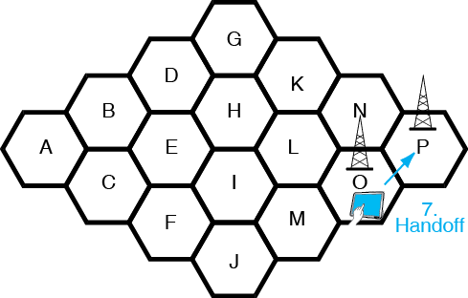
10.19: Cellular Technology

Slide 56
10.22: Handoff and Roaming in 802.11 and Cellular Networks
 | Handoff | Roaming | Mean the Same Thing?
802.11 | From one access point to another | From one access point to another | Yes
Cellular telephony | From one cellsite to another within the same carrier’s system in a city | From a system in one city to a carrier system in another city | No

Slide 57
10.23: Generations of Cellular Service
Cellular telephony has gone through several technological generations.
Generation 1 (1G)
1980s
Analog signaling
Data transmission difficult, limited to 10 kbps

Slide 58
10.23: Generations of Cellular Service
Generation 2 (2G)
1990s
Digital signaling
Data transmission easier but still limited to 10 to 20 kbps
Sufficient for texting

Slide 59
10.23: Generations of Cellular Service
Generation 3 (3G)
Around 2001
Requirement to give at least 2 Mbps download speeds to stationary customers
Requirement to give at least 384 kbps download speeds to moving customers
Throughput far lower in practice initially, typically about 100 to 500 kbps stationary but still far higher than 2G

Slide 60
10.23: Generations of Cellular Service
Generation 3 (3G)
Created an explosion in data use.
Web surfing, streaming video, file synchronization, and so on are possible.
Soon, some laptop computers used 3G service.
Eventually, tablets and other devices used 3G.
Cellular service was not just for phones anymore.

Slide 61
10.23: Generations of Cellular Service
Generation 4 (4G)
Speed Requirements
Designed to give at least 1 Gbps download speeds to stationary customers
Designed to give at least 200 Mbps download speeds to moving customers
Makes wireless as good as or better than wired Internet access
Sufficient for heavy Web downloading
Sufficient for high-quality streaming video

Slide 62
10.23: Generations of Cellular Service
Generation 4 (4G)
Technical Characteristics
Uses IP, typically IPv6
MIMO
Scalable bandwidth 5 to 20 MHz
From high but economical speeds to ultrahigh speeds
Strong quality of service management

Slide 63
Today: Closing the Gap
3G systems grew well beyond the initial requirements.
2013: two services are dominant
HSPA+ (High-Speed Packet Access)
42 Mbps rated speed in the best systems
Half that in most
Actual typical speed is 7 Mbps down, 1 Mbps up
LTE (Long-Term Evolution)
Actual typical speed: 10 Mbps down, 6 Mbps up

Slide 64
Which Services are 4G?
LTE Advanced
Will be a full 4G service
Likely to dominate 4G eventually
LTE
International Telecommunications Union 2010
Said that precursors of 4G may be called 4G
This applied to LTE
HSPA+
Not a precursor to a 4G system, so not a 4G service

Slide 65
WiMAX
Competitor for LTE
Highly comparable to LTE
Not thriving in the marketplace
Probably a dead-end or niche technology

Slide 66
10.24: Lies, Damned Lies, and Service Speeds
Customer Throughput Varies with Many Factors
Specific technology used (e.g., LTE)
Specific options used for the technology (very large effect)
Channel bandwidth
MIMO or not

Slide 67
10.24: Lies, Damned Lies, and Service Speeds
Customer Throughput Varies with Many Factors
Time of Day
During the day, there are variations
More traffic in the day, so slower

Slide 68
10.24: Lies, Damned Lies, and Service Speeds
Customer Location
Customer is near center or edge of cell (distance hurts)
Building or terrain obstructions
In some locations, there may be too few cellsites

Slide 69
10.24: Lies, Damned Lies, and Service Speeds
Customer Throughput Varies with Many Factors
Number of customers sharing the cell at the moment
Speed decreases approximately linearly with the number of customers
Whether the carrier minimizes this by having many cells (more expensive for the carrier)

Slide 70
10.24: Lies, Damned Lies, and Service Speeds
Customer Throughput Varies with Many Factors
Smartphone technology and engineering
Most older smartphones cannot handle the latest carrier offerings at full speed
They will communicate using a slower older standard

Slide 71
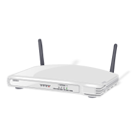


10.25: Cellular-802.11 Convergence
Traditional Roles
802.11 devices received service within a building.
Mobile phones received cellular service outside.
802.11
Cellular

Slide 72
10.25: Cellular-802.11 Convergence
Dual Mode Smartphones
By default, use cellular network for calls.
Also connect directly to 802.11 WLANs.
Customers like this because it gives faster speeds than cellular transmission.
Customers like this because it helps them stay under their transmission quota limits.
Cellular companies like offloading traffic from flat-fee users.

Slide 73
10.25: Cellular-802.11 Convergence
Some Smartphones Can Act as Access Points
Provide service to multiple 802.11 devices.
Carriers charge a premium for this because it adds to their cost.
ISP
802.11
Cellular
Carrier

Slide 74
LANs, MANs, and WANs
Access Lines
The Network Core
Using the Internet for Wide Area Networking
Cellular Data Service
Virtual WANs

Slide 75
10.26: Virtual WANs
Most companies have multiple WAN technology components
Leased line networks
PSDNs of different types
Internet transmission
Cellular transmission
Different access link technologies

Slide 76
10.26: Virtual WANs
Traditionally, each component has been managed separately.
However, traffic between hosts often passes through multiple components.
This makes it difficult to manage overall performance and efficiency.

Slide 77
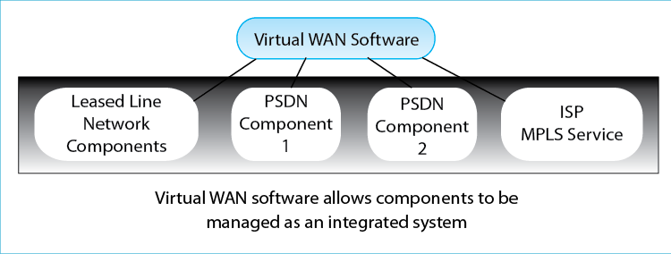
10.26: Virtual WANs
Virtual WAN software provides overall management of the individual WAN components.

Slide 78
10.26: Virtual WANs
Virtual WAN software provides overall management of the individual WAN components.
Allows the overall management of performance and efficiency.
Individual components can be added, dropped, or changed easily as technology changes.
It may be possible to simulate the effects of changes before implementation.

